Slide 1

CSC 533: Privacy in the Digital Age (Fall 2020)
Lecture 17: Privacy Acts and Frameworks
Anupam Das
Oct. 15, 2020

Slide 2
Goals for today
Learn the basics of the following privacy acts
HIPPA
FERPA
COPPA
GDPR
CCPA
Learn the basics of popular/emerging privacy frameworks
OECD
APEC
NIST
IAPP

Slide 3


HIPPA: What is HIPPA?
Acronym for Health Insurance Portability & Accountability Act of 1996 (45 C.F.R. parts 160 & 164).
Provides a framework for
establishment of nationwide protection of patient confidentiality,
security of electronic systems,
standards and requirements for electronic transmission of health information.

Slide 4
When does HIPPA apply?
HIPAA does not protect all health information. Nor does it apply to every person who may see or use health information. HIPAA only applies to covered entities and their business associates.
Covered entities:
Health care providers (hospitals, pharmacies)
Health plan provider (Insurance provider)
Health care clearinghouses (help process information so that it can be transmitted in a standard format)
A "business associate" creates, receives, maintains, or transmits protected health information (PHI) on behalf of a covered entity or another business associate acting as a subcontractor.

Slide 5

Breaking down HIPPA
Overseen by: Department of Health & Human Services (HHS) and enforced by Office for Civil Rights (OCR)
Regulations on:
Privacy of health information
Security of health information
Notification of breaches of confidentiality
Penalties for violating HIPAA
Looking inside the HIPPA HIPPO

Slide 6
HIPPA: The privacy rule
Protects information known as PROTECTED HEALTH INFORMATION (PHI) that exists in written, oral and electronic formats. PHI includes -
Name
Date of Birth
Fax Number
Account Number
Web Universal Resource Locator (URL)
Street Address
Electronic mail address
Certificate/License Number
License Plate Number
City
Discharge Date
Social Security Number
Vehicle and Serial Number
Device Identifier and Serial Number
Precinct
Date of Death
Medical Record Number
Internet Protocol Number
Full Face Photographic Images
Zip Code
Telephone Number
Health Plan Beneficiary Number
Biometrics Identifiers (i.e. finger prints)
Any other Unique Identifying Number, Characteristic, or Code

Slide 7
HIPPA: The privacy rule
Limits the way in which members of a health/care provider may use and disclose (release) PHI. HIPAA promotes the MINIMUM NECESSARY standard (minimum information required to get the job done).
Allows individuals to:
get a copy of their medical records
ask for changes to their medical records
find out and limit how their PHI may be used
know who has received their PHI
have communications sent to an alternate location or by an alternate means
file complaints and participate in investigations

Slide 8
Exceptions for disclosure
Organizations may disclose information, without a member’s authorization, to the appropriate authorities:
if required by law, court order, etc.
to public health officials, FDA, etc.
for abuse or domestic violence
to help law enforcement officials
to notify of suspicious death
to provide information for workers’ compensation
to assist government actions
to help in disaster relief efforts
to avert a serious threat to health or safety
for health oversight activities

Slide 9

Good practice for privacy compliance
Don’t disclose PHI without verifying the right credentials of the requester.
Do not include any patient identifiers in the subject line of an email.
Do not discuss PHI in public or common areas.
Avoid faxing PHI, if possible. If needed make sure to check the fax number for accuracy before sending a fax that contains PHI. If a fax is sent to the wrong recipient in error, inform your Supervisor or Manager

Slide 10
Good practice for security compliance
Use passwords and strong ones. Don’t share your passwords
Log off computer systems when you leave your desk
Turn monitors so that they are not visible to others
Dispose of disks and CDs properly (Contact the IT Dept. for disposal assistance)
Always save PHI to shared directory – not personal drives
If you use mobile media devices such as laptops and USB drives, make sure they are encrypted.
Use encrypted emails for communications

Slide 11
Breach of confidentiality
A breach is, generally, an impermissible use or disclosure under the Privacy Rule that compromises the security or privacy of the protected health information.
When a breach is identified, each individual whose unsecured PHI has been, or believed to have been accessed, acquired or disclosed has to be notified by written mail or email.
Required notifications must occur without unreasonable delay (no more than 60 calendar days after discovery).
If the contact address of 10 or more individuals is out dated, organizations may post notice on the home page for at least 90 days or use other major print or broadcast media where the affected individuals likely reside.

Slide 12
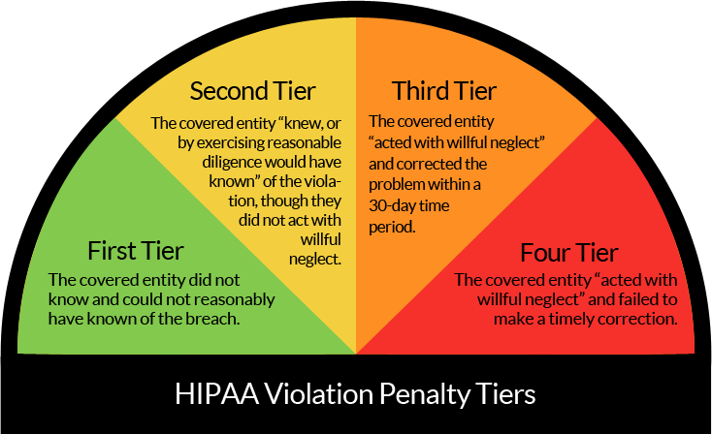
Non-compliance penalties
$10,000 -$50,000 per incident
$1000 -$50,000 per incident
$100 -$50,000 per incident
$50,000 per incident

Slide 13
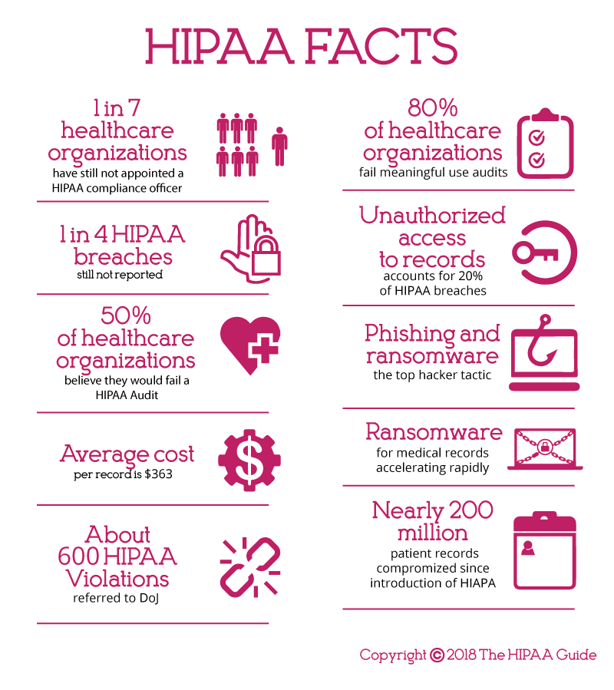
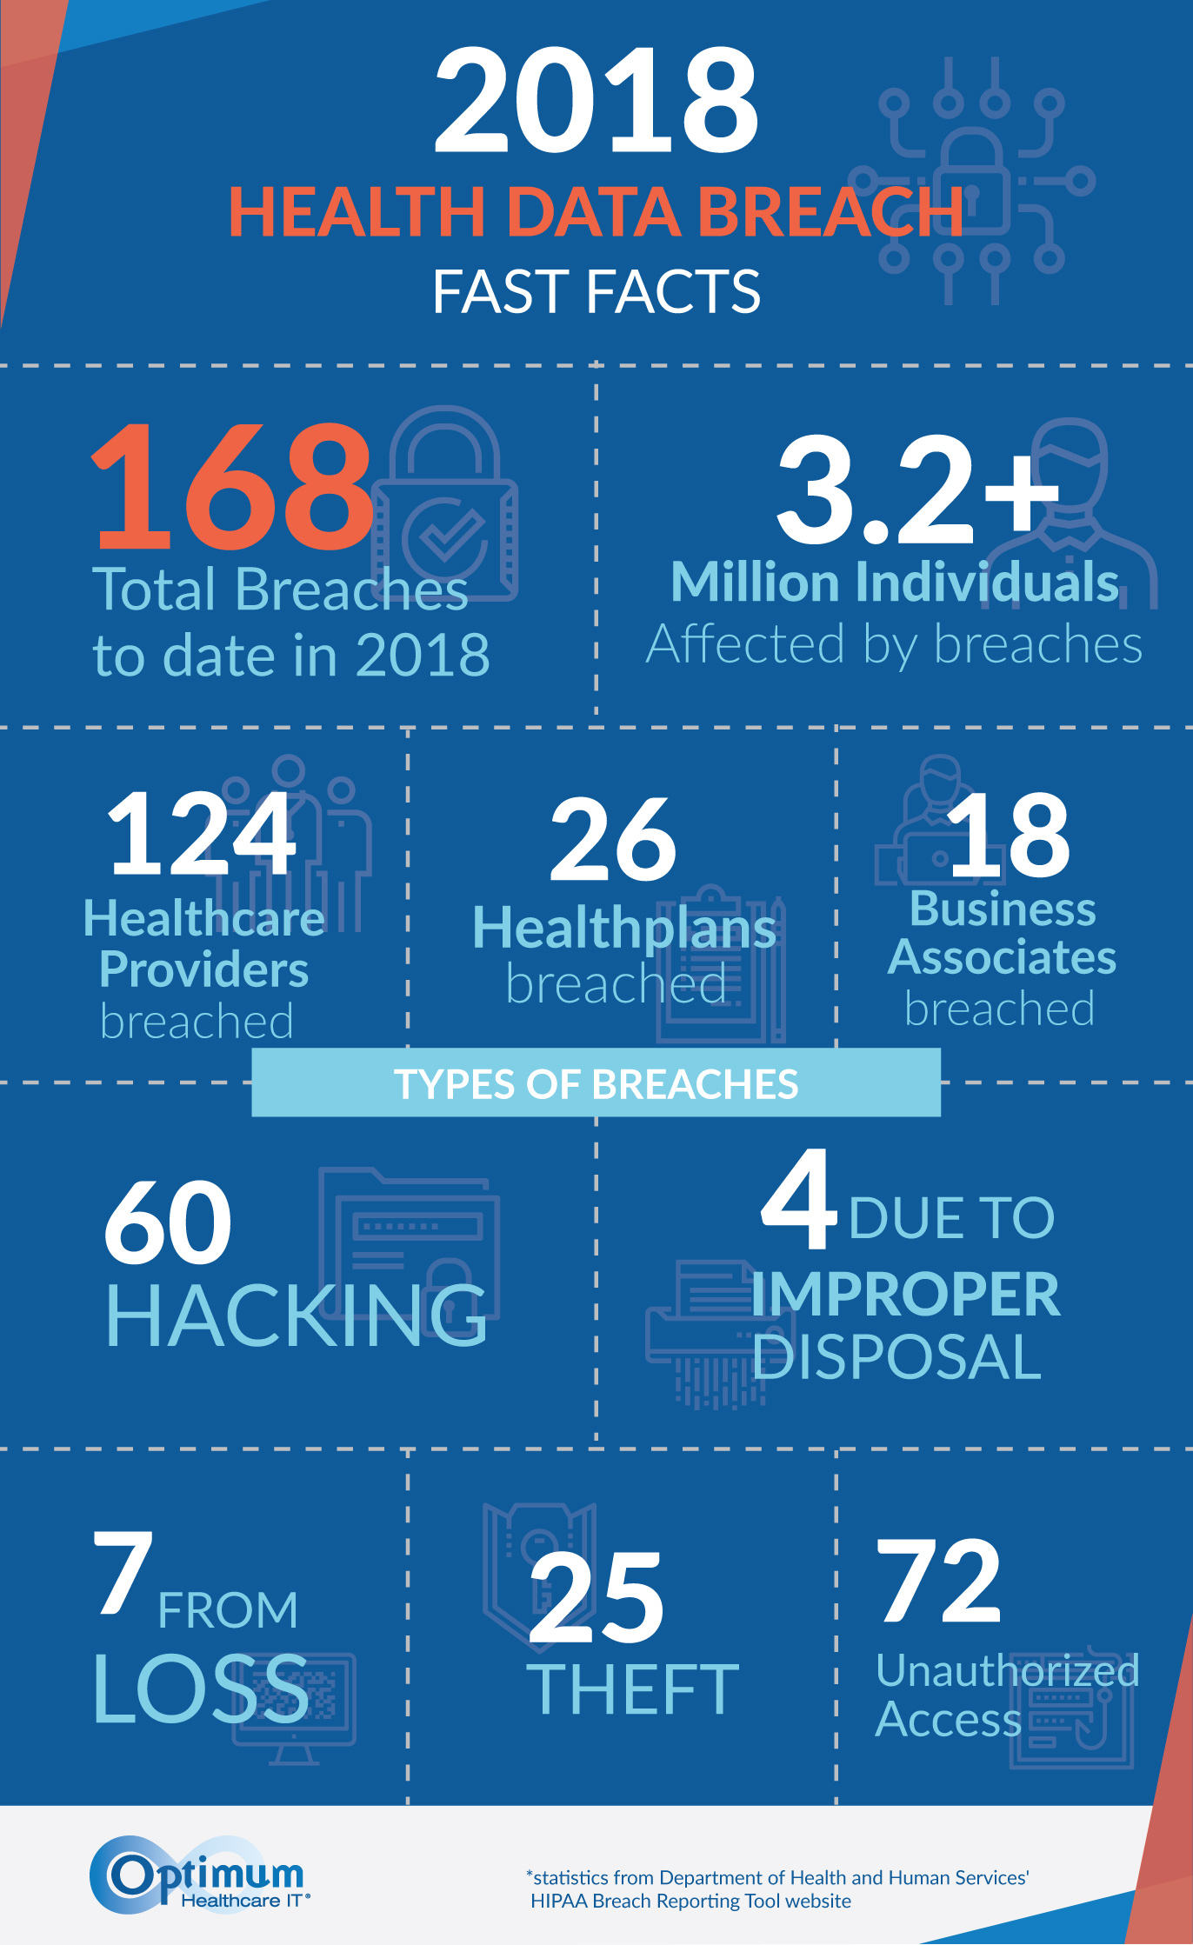

Slide 14
2020 breach penalties
Date | Organization | Fine Total | Link to OCR Settlement
3/3/2020 | The practice of Steven A. Porter, M.D | $100,000 | Health Care Provider Pays $100,000 Settlement to OCR for Failing to Implement HIPAA Security Rule Requirements
7/23/2020 | Metropolitan Community Health Services | $25,000 | Small Health Care Provider Fails to Implement Multiple HIPAA Security Rule Requirements
7/27/2020 | Lifespan Health System | $1,040,000 | Lifespan Pays $1,040,000 to OCR to Settle Unencrypted Stolen Laptop Breach
9/15/2020 | Housing Works, Inc | $38,000 | OCR Settles Five More Investigations in HIPAA Right of Access Initiative
9/15/2020 | All Inclusive Medical Services, Inc | $15,000 | OCR Settles Five More Investigations in HIPAA Right of Access Initiative
9/15/2020 | Beth Israel Lahey Behavioral Services | $70,000 | OCR Settles Five More Investigations in HIPAA Right of Access Initiative
9/15/2020 | King MD | $3,500 | OCR Settles Five More Investigations in HIPAA Right of Access Initiative
9/15/2020 | Wise Psychiatry, PC | $10,000 | OCR Settles Five More Investigations in HIPAA Right of Access Initiative
9/21/2020 | Athens Orthopedic Clinic PA | $1,500,000 | Orthopedic Clinic Pays $1.5 Million to Settle Systemic Noncompliance with HIPAA Rules
9/23/2020 | CHSPSC LLC | $2,300,000 | HIPAA Business Associate Pays $2.3 Million to Settle Breach Affecting Protected Health Information of Over 6 million Individuals
9/25/2020 | Premera Blue Cross | $6,850,000 | Health Insurer Pays $6.85 Million to Settle Data Breach Affecting Over 10.4 Million People
10/7/2020 | Dignity Health, DBA St. Joseph’s Hospital and Medical Center | $160,000 | OCR Settles Eighth Investigation in HIPAA Right of Access Initiative
10/9/2020 | NY Spine Medicine (NY Spine) | $100,000 | OCR Settles Ninth Investigation in HIPAA Right of Access Initiative
 | 2020 TOTAL: | $12,211,500
https://compliancy-group.com/hipaa-fines-directory-year/

Slide 15

FERPA (1974)
It is a Federal law: the Family Educational Rights and Privacy Act, and federal regulations - (34 CFR Part 99).
FERPA is enforced by the U.S. Department of Educations’ Family Policy Compliance Office.

Slide 16
What is FERPA
It gives right to students enrolled at an educational institution to:
inspect and review their own educational records.
seek and amend education records.
control over the disclosure of information from the education records.
FERPA contains specific exceptions which allow the institution to use or disclose an Education Record without the students’ consent.

Slide 17
What is educational record?
‟Education Records” are defined by FERPA as any records which…
contain information directly related to a student who is, or was in attendance at an educational institution; and
are maintained by the institution, or by a party acting for institution.

Slide 18
Education records include:
ALL records in any format including: emails to, from, or about a student maintained by a faculty or staff member in a personal or private email account, test papers, essays, computer records, tracking information from a card swipe, film, photos, videos, audio tape, records of disciplinary hearings, application files of any individual enrolled or previously enrolled as a student.
Personally Identifiable Information: Information obtained from Education Records that, alone or combined with other information, can be used to identify a student.

Slide 19
Education records include:
Employment records of students working in jobs designated as ‟work-study” positions.
‟Education Records” created or maintained by a third party that has a contract to provide a service that the institution could have performed internally.
EDUCATION RECORDS ARE EVERYWHERE!

Slide 20
Examples of non-education data
Information that is personally observed by a staff or faculty member;
Records created and maintained by a law enforcement unit solely for law enforcement purposes;
Employment records of individuals who are employed in a job that does not require student status and can be filled by any person;
Medical records made and maintained about treatment provided to students by a health care provider in the campus;
Financial information about a student’s parent or guardian;
Application files of individuals who do not enroll as students;

Slide 21
Parents and FERPA
At the K-12 level, FERPA provides parents of students under the age of 18 the right to review their children’s Education Records and to give consent to access and to the release of the records in the absent of an exception.
At the University level, this right transfers to the student, even if the student is under the age of 18 and/or the parent is paying the student’s tuition.

Slide 22
Exceptions for disclosure
To authorized Federal, State and local educational authorities for audit or evaluation of education programs
Developing, validating or administering predictive tests; administering student aid programs; or improving instruction;
School official with legitimate educational interest
To comply with a judicial order or a lawfully issued subpoena;
Heath or safety emergencies

Slide 23
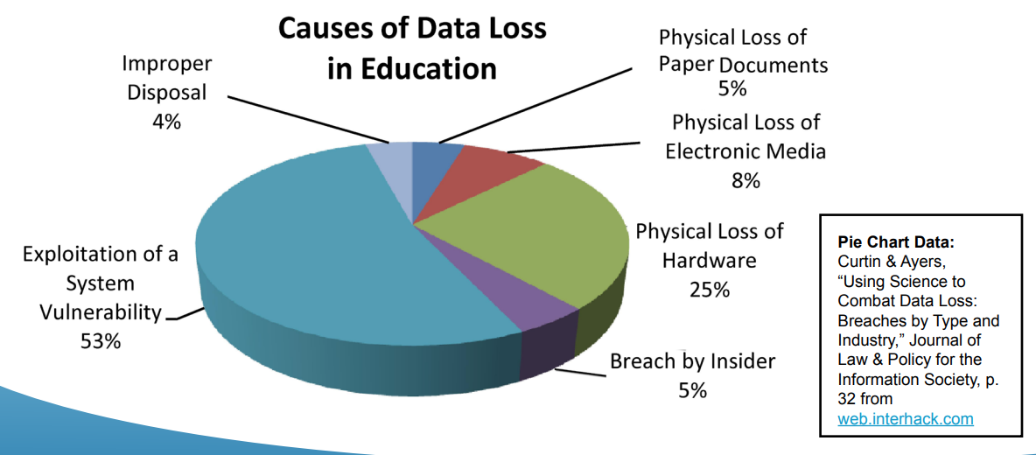
Penalty for non-compliance
Failure to comply could result in the withholding of Federal Funds, including Student Financial Aid.

Slide 24
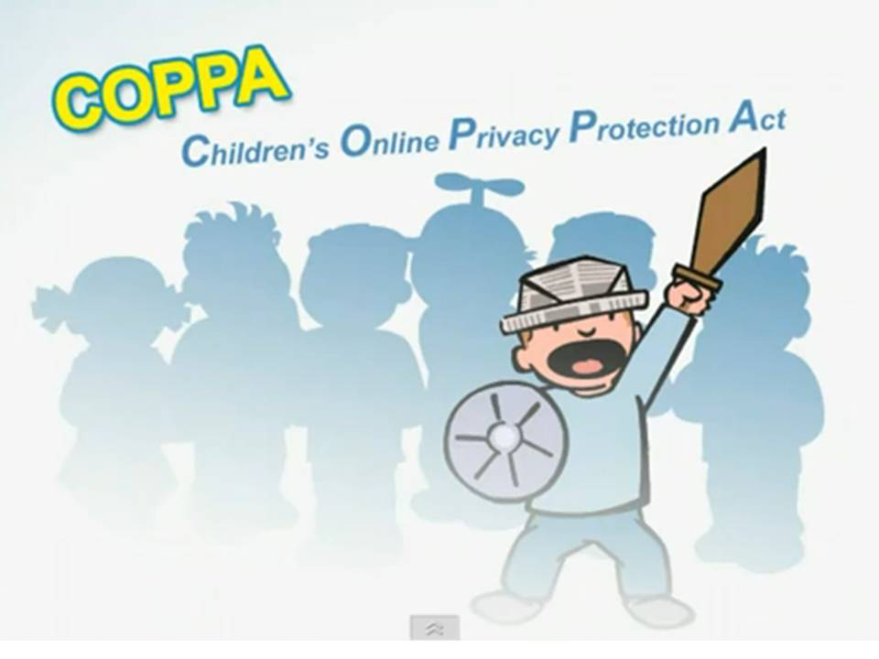
COPPA
Children Online Privacy Protection Act of 1998
Effective since the year 2000
Enforced by the Federal Trade Commission (FTC)
Designed with consumer protection in mind
Grants parents control over the information collected from children online

Slide 25
What COPPA is not
Not a censorship measure– does not regulate website content or limit the information that can be collected through a website or online service;
Not grounds for a private cause of action– only the federal government can enforce COPPA;
Not designed to capture online predators, nor is it a crime fighting tool
Not international law

Slide 26
When does COPPA apply?
You must comply with COPPA notification and data protection/disposal regulations if:
You run a website or online service (like games or apps) that:
Collects “personal information”, allows other third parties (apps and plug ins) to collect personal information, or you are the third party;
Is directed towards children under the age of 13; or
Is directed towards a general audience, but you have actual knowledge that you collect information from the under 13 demographic

Slide 27
What qualifies as children content?
No hard and fast guidelines to determine whether a game or website is “directed to children under the age of 13”;
Factors taken into consideration include
Use of animation/cartoons
Nature of the content
Child-oriented activities
Age of models
Presence of child celebrities or characters/celebrities that appeal to kids

Slide 28
Data types that fall under COPPA
If you collect any of the following end user information you may need to comply with COPPA:
Full name
Home or other physical address, phone number, social security number
Screen name or user name that enables direct contact with the user (via VOIP, e-mail, IM, direct message)
Photos, videos, or audio files containing a child’s image or voice
Geolocation information
Persistent identifiers– cookies, IP addresses, processor or device number or identifier

Slide 29
Penalties of COPPA non-compliance
FTC enforcement actions;
Parents, competitors, etc. can submit complaint to FTC for investigation;
Can be enforced by both states and other federal agencies;
Penalty fees: up to $40,654 per violation;
COPPA can apply to foreign entities if you distribute your game to US audiences

Slide 30
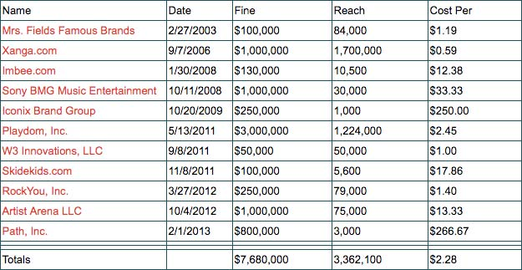
COPPA penalty examples
Google LLC and its subsidiary YouTube, LLC will pay a record $170 million to settle allegations: collected personal information from children without their parents’ consent
https://www.privo.com/history-of-coppa-violations

Slide 31
Six step towards COPPA compliance
Step 1: Determine if Your Company is a Website or Online Service that Collects Personal Information from Kids Under 13.
Step 2: Post a Privacy Policy that Complies with COPPA.
Step 3: Notify Parents Directly Before Collecting Personal Information from Their Kids.
Step 4: Get Parents’ Verifiable Consent Before Collecting Personal Information from Their Kids.
Step 5: Honor Parents’ Ongoing Rights with Respect to Personal Information Collected from Their Kids.
Step 6: Implement Reasonable Procedures to Protect the Security of Kids’ Personal Information.

Slide 32
EU’s GDPR
The General Data Protection Regulation (GDPR) is a new law in the European Union (EU) providing for uniform data protection regulation throughout the EU.
Went effect on May 25, 2018, and represents one of the highest standards of privacy and data protection in the world
Will enable EU Data Protection Authorities (DPAs) the ability to regulate and bring enforcement against companies across the globe.
2012 - 2015
2016 - 2017
2018
Two-year implementation phase
Jan 2012
European Commission publishes GDPR legislative proposal
Dec 2015
GDPR approval reached
Apr 2016
GDPR formally adopted by EU
Early 2018
Operational readiness for privacy program capabilities
May 2018
GDPR in effect, enforcement actions begin
https://chapters.theiia.org/puget-sound/ChapterDocuments/GDPR%20Briefing%20Deck%20for%20IIA%20meeting%209.21%20v2.pptx

Slide 33
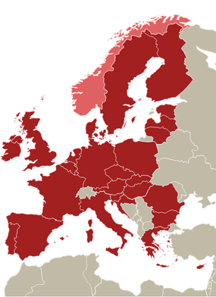
GDPR’s impact
GDPR is location based not citizen based
GDPR applies to every company that collects personal data from EU data subjects, regardless of where the company is established
It applies to data processors as well as data controllers
It applies to companies that offer goods or services in the EU, regardless of whether payment is required, or monitor the behavior of EU residents
It broadens the term Personal Data – “any information that directly or indirectly can be related to an identified or identifiable natural person”
It may impact US operations if EU products and business processes can not be easily carved out or EU data is transferred to/used in the US
Major impact to the collection /processing of:
EU
Consumer
Data
EU
Employee
Data
EU
Business
Customer
Data
https://chapters.theiia.org/puget-sound/ChapterDocuments/GDPR%20Briefing%20Deck%20for%20IIA%20meeting%209.21%20v2.pptx

Slide 34
GDPR Privacy requirements
Implement and manage technical and organizational privacy program controls
Strategy & Governance
Appoint a Data Protection Officer
Proactively identify and mitigate privacy risk at the onset of new initiatives, then continually thereafter
Privacy by Design
Policy Management
Demonstrate accountability through compliance, monitoring and auditing, and policy management process
Information Security
Training & Awareness
Formally assess privacy impact across new and evolving initiatives
Maintain records of processing activities (e.g. data inventories)
Cross-Border
Data Strategy
Data Lifecycle Management
Only share personal data with third parties that are able to demonstrate compliance with GDPR
Provide expanded rights to data subjects, including control (e.g. consent), deletion or portability, restriction of processing
Data Processor Accountability
Individual Rights Processing
Strict new contracting requirements for engaging with third parties
Privacy Incident Management
Breach notification to regulators within 72 hours
https://chapters.theiia.org/puget-sound/ChapterDocuments/GDPR%20Briefing%20Deck%20for%20IIA%20meeting%209.21%20v2.pptx

Slide 35
Risks of non-compliance
Regulatory Risk
Enhanced territorial scope impacts operations far beyond the EU • Aggressive regulators with broader audit rights • Increased scrutiny for high-risk data processing activities • Localization requirements and other regulator restrictions
Financial Risk
Potentially massive statutory fines for violations – 20 million Euros or 4% of the total global annual revenue/sales (whichever is higher) • Increased risk of civil suits and class actions for violating rights of individuals • People, process, and technology impact to execute required privacy program capabilities
Operational Risk
Barrier to entry for business that lack GDPR compliance • Shorter breach reporting windows • Adverse outcomes with business partners or customer negotiations over privacy obligations • Individual empowerment to object to data processing and other requests
Reputational Risk
Data breaches damage the brand • Poorly perceived data collection and use practices impacts consumer sentiment • Influences relationships with the regulators • Poor reputations drive watchdog and advocacy groups
https://chapters.theiia.org/puget-sound/ChapterDocuments/GDPR%20Briefing%20Deck%20for%20IIA%20meeting%209.21%20v2.pptx

Slide 36





GDPR in action so far
Under observation
https://www.nathantrust.com/gdpr-fines-penalties

Slide 37
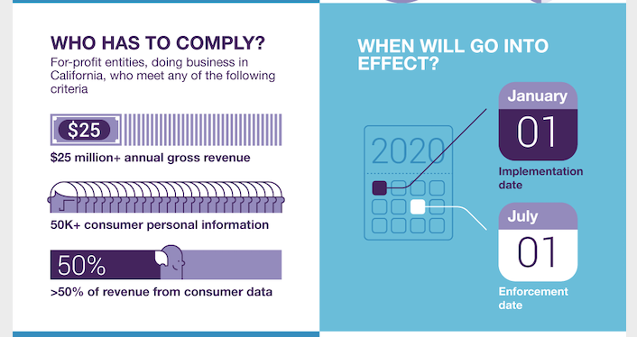
California Consumer Privacy Act (CCPA)

Slide 38
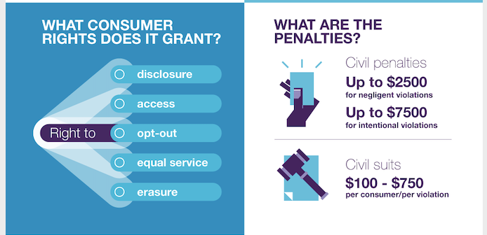
Rights and Penalties

Slide 39
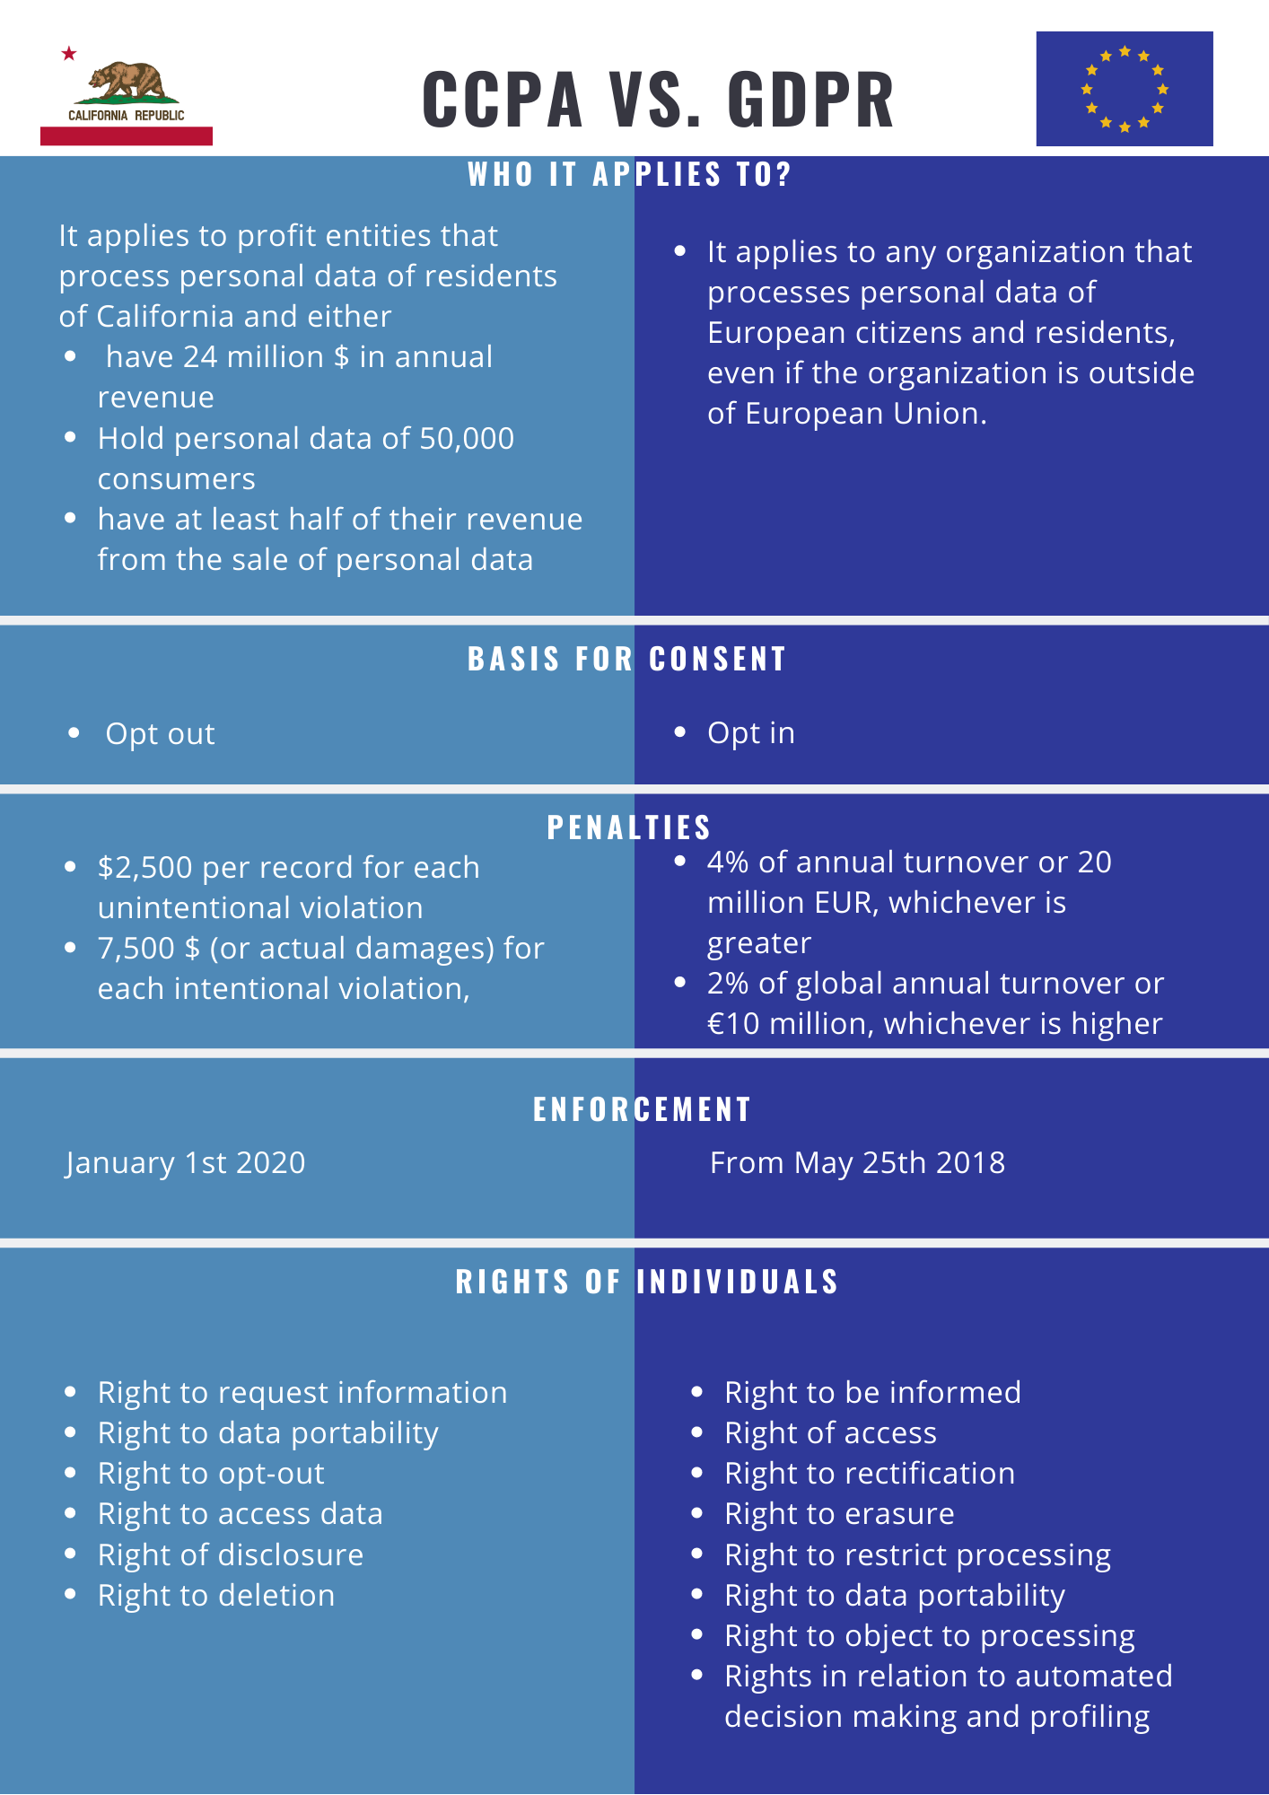
CCPA vs. GDPR
Big companies vs. any companies
Opt out vs. Opt in
Weaker penalties vs. stronger penalties
More personal control in GDPR

Slide 40
Privacy Principles/Frameworks

Slide 41
OECD Privacy Frameworks
OECD Privacy Principles provide internationally the most commonly used privacy framework (1980)
Collection Limitation Principle
Data Quality Principle
Purpose Specification Principle
Use Limitation Principle
Security Safeguards Principle
Openness Principle
Individual Participation Principle
Accountability Principle
http://oecdprivacy.org/
OECD: Organization for Economic Co-operation and Development

Slide 42
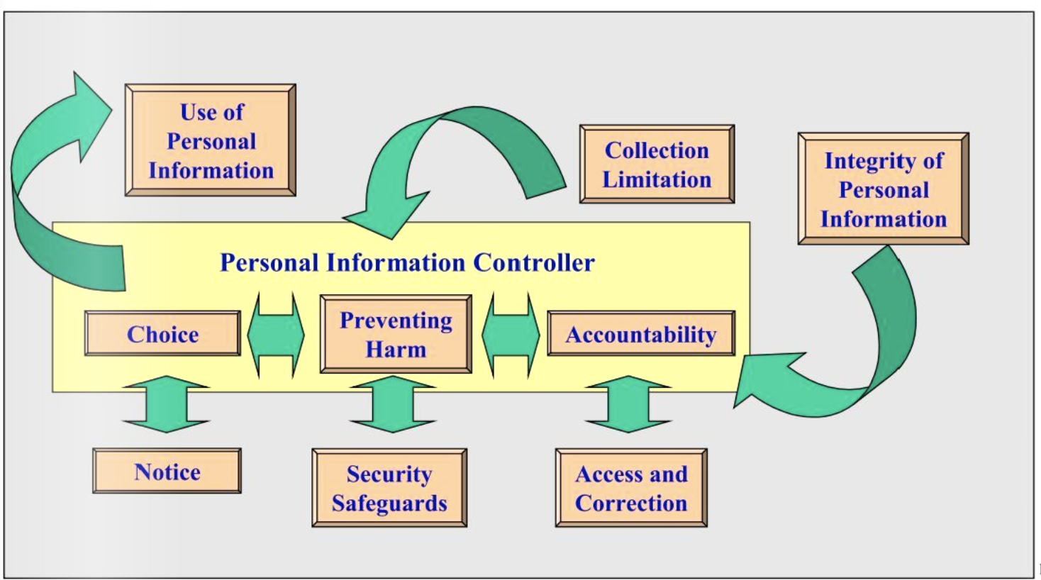
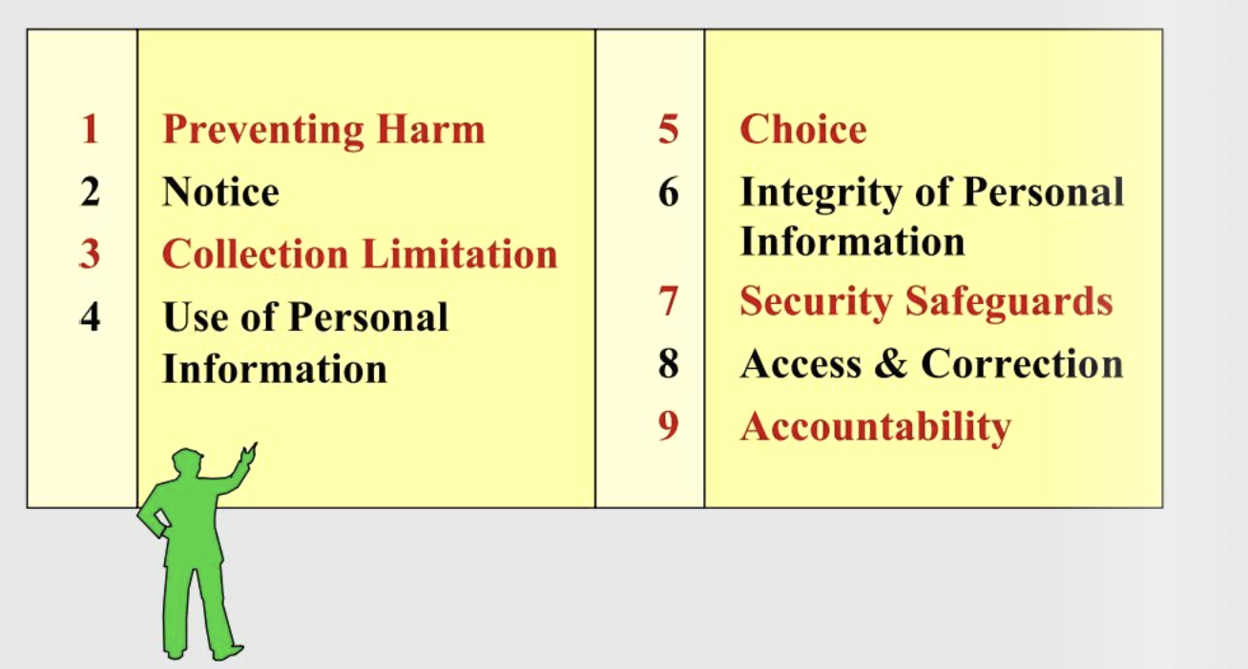
APEC Privacy Framework
https://www.yumpu.com/en/document/read/40566302/an-overview-of-the-principles-established-by-the-apec-privacy-
APEC: Asia-Pacific Economic Cooperation

Slide 43
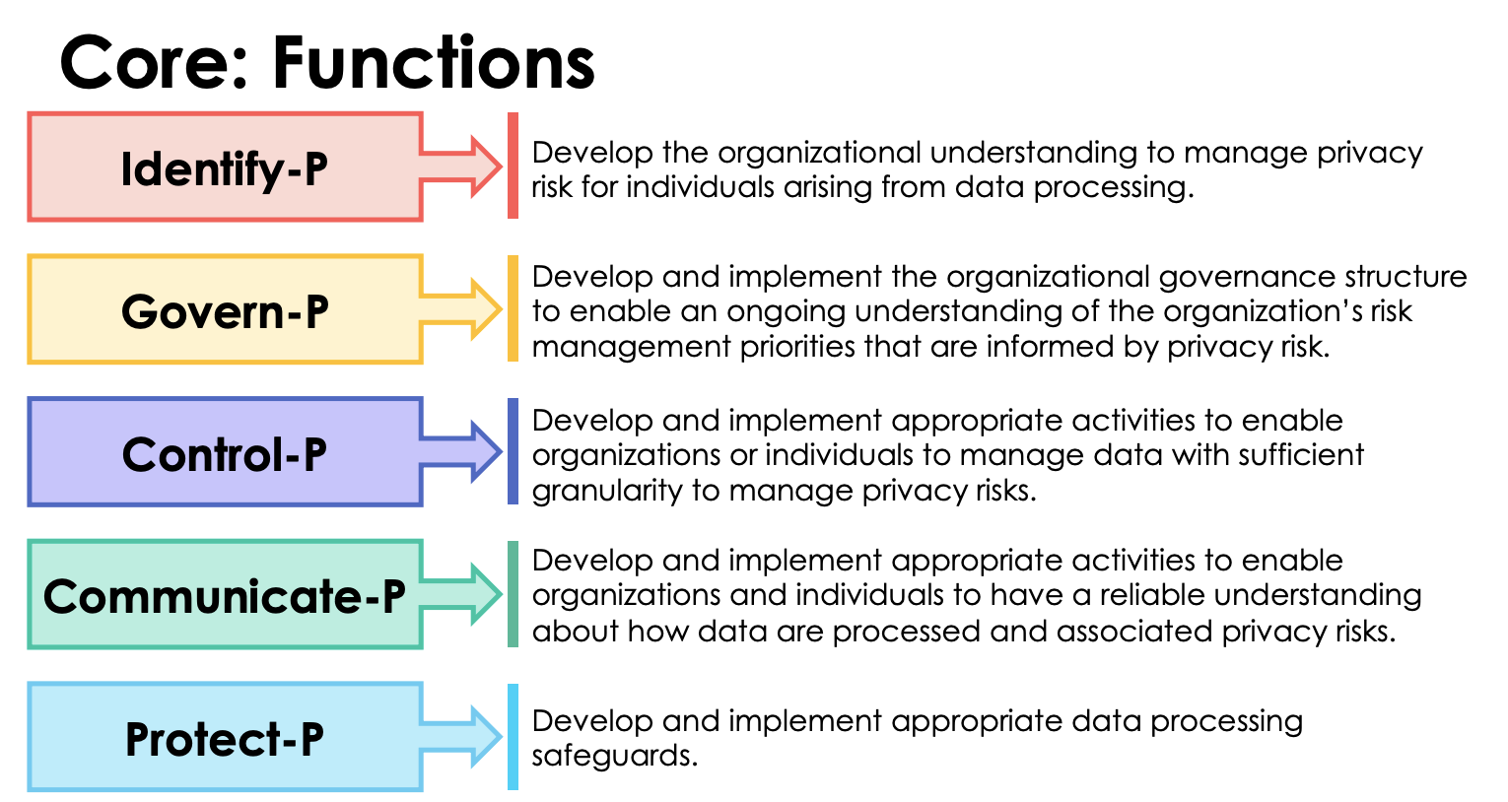
NIST Privacy Framework (working draft)
https://www.nist.gov/sites/default/files/documents/2019/09/09/nist_privacy_framework_preliminary_draft.pdf

Slide 44
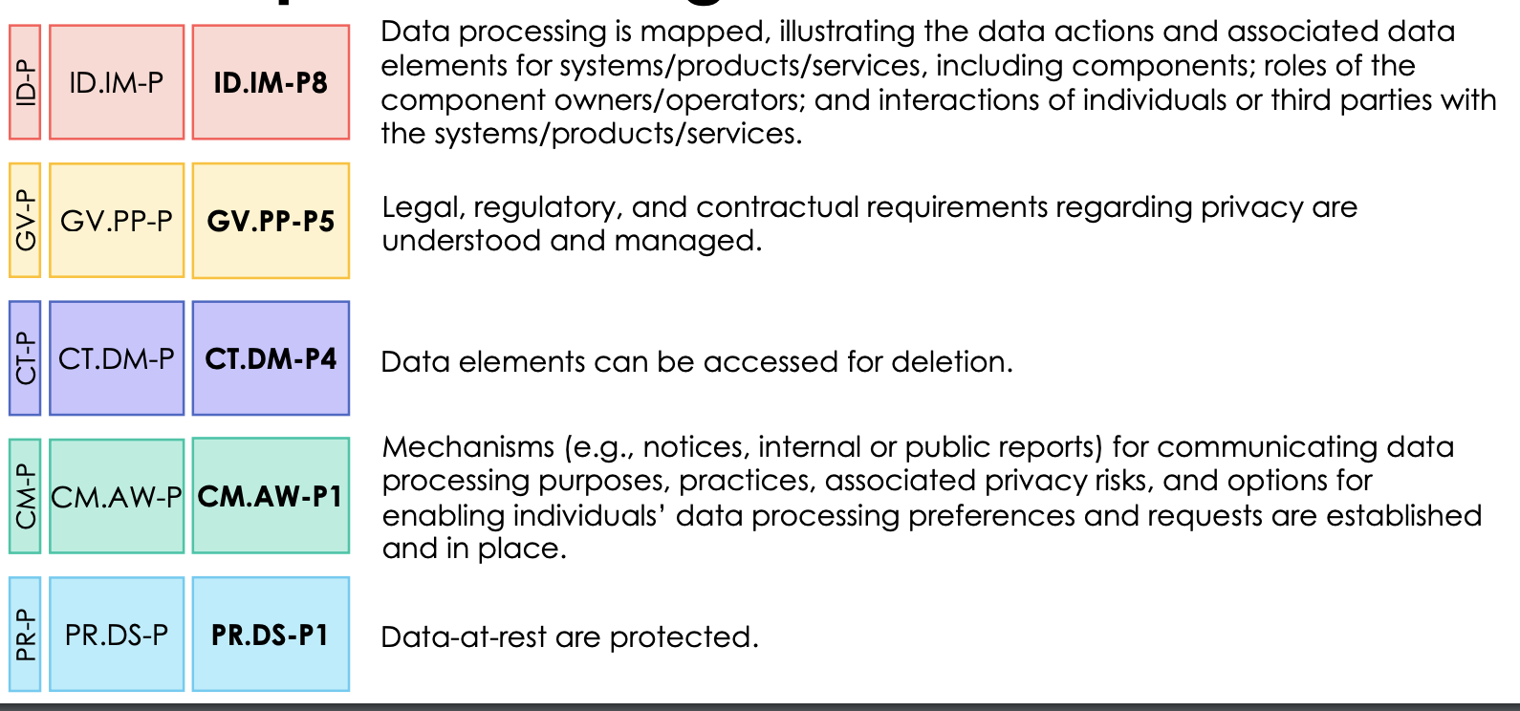
NIST Privacy Framework (working draft)

Slide 45
IAPP’s Privacy by Design
Proactive not Reactive: Privacy by Design comes before-the-fact, not after.
Privacy as the Default: No action is required on the part of the individual to protect their privacy − it is built into the system, by default
Privacy Embedded into Design: Privacy becomes an essential component of the core functionality being delivered
Full Functionality – Positive-Sum, not Zero-Sum: Privacy by Design avoids the pretense of false dichotomies, such as privacy vs. security
End-to-End Security – Lifecycle Protection: Strong security measures are essential to privacy, from start to finish.
Visibility and Transparency: Operating according to the stated promises and objectives, subject to independent verification.
Respect for User Privacy: Strong privacy defaults, appropriate notice, and empowering user-friendly options.
IAPP: International Association of Privacy Professionals
https://iapp.org/media/pdf/resource_center/Privacy%20by%20Design%20-%207%20Foundational%20Principles.pdf

Slide 46
Logistics
Homework 4 due Oct 23 @11:59pm

